Slide 1
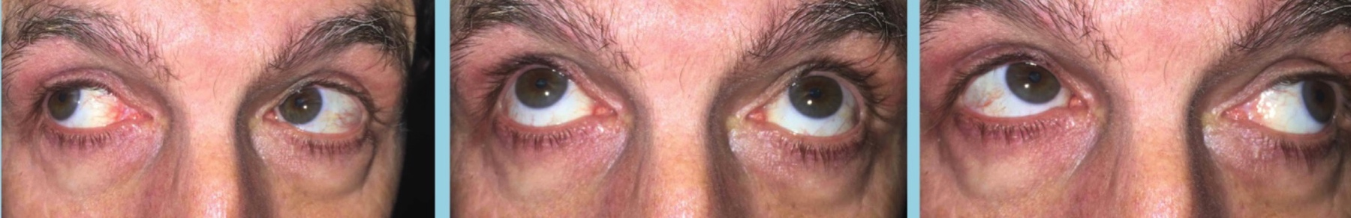

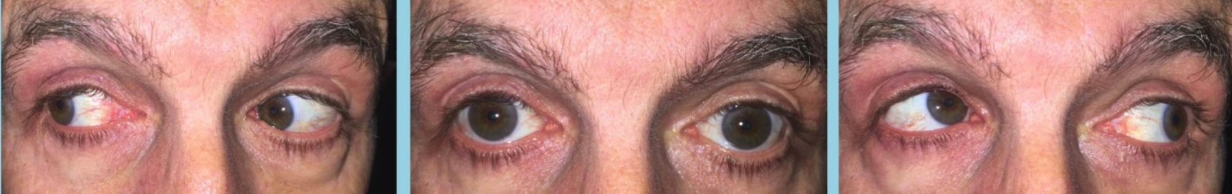
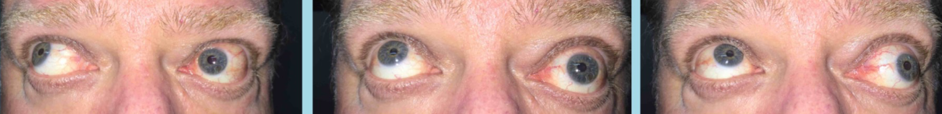

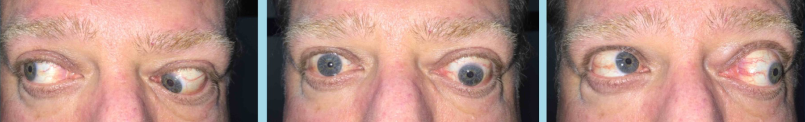

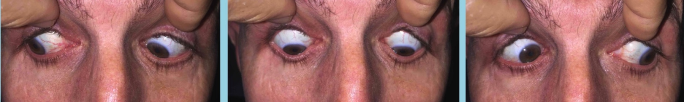
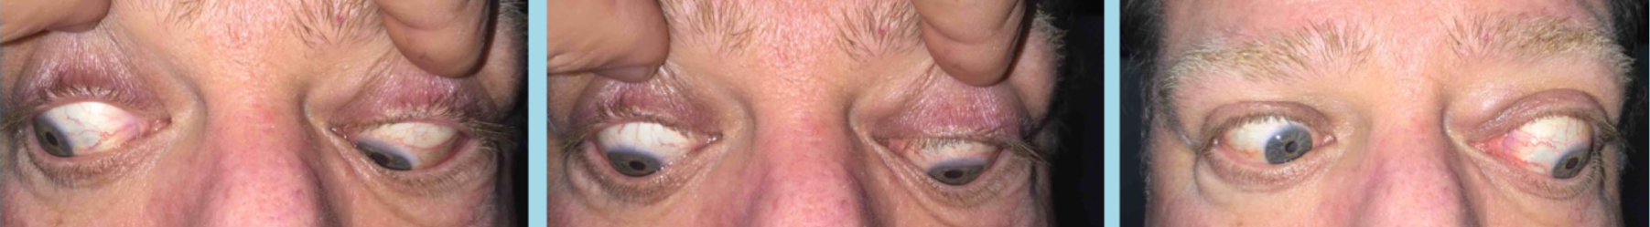
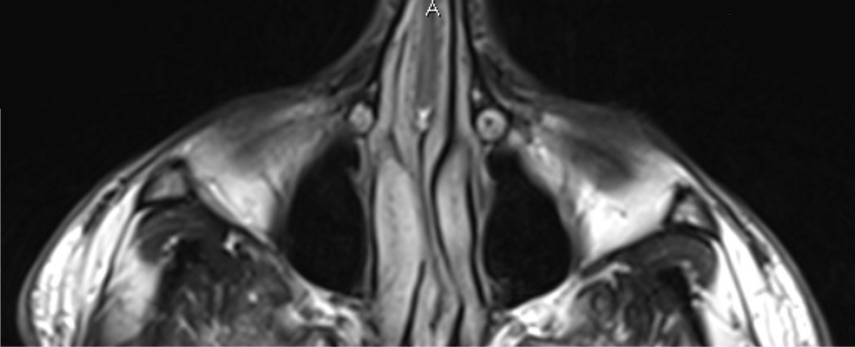
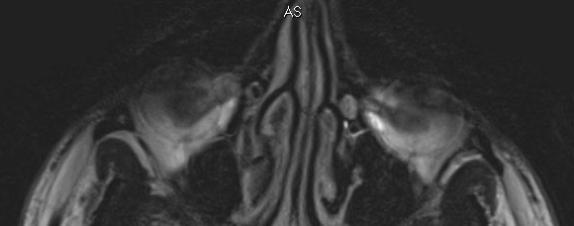
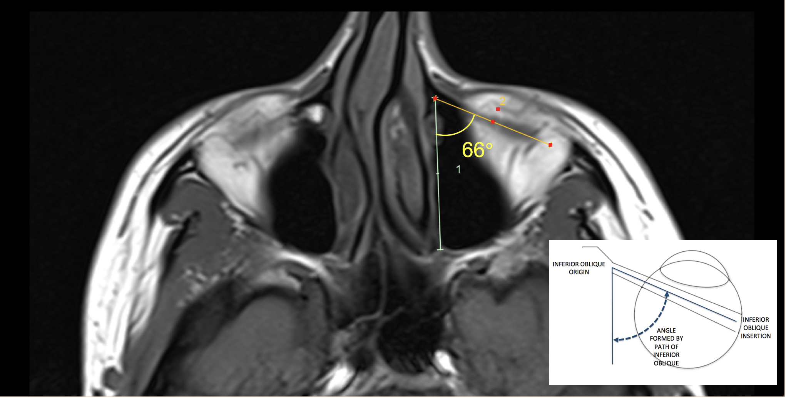
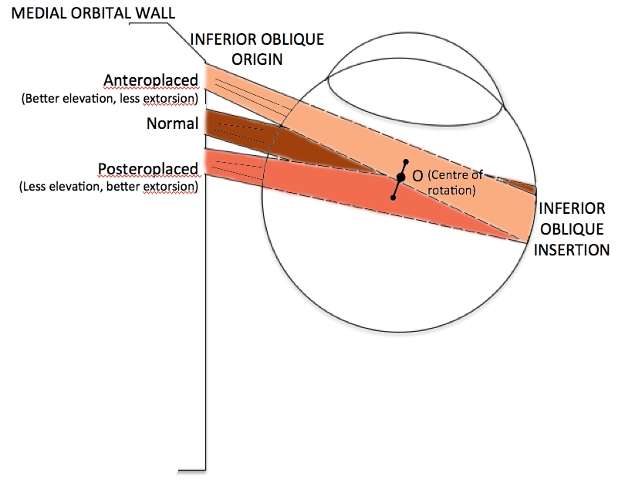
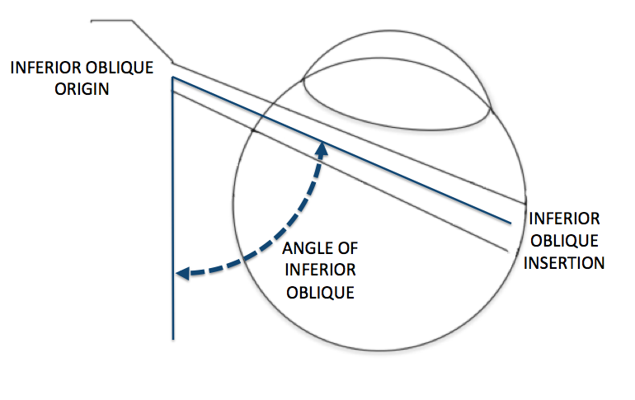
The Radiology of the Inferior Oblique and its Clinical Implications
Shivanand Sheth^{1,2}, Mali Okada¹, Thomas Campbell¹, Lionel Kowal¹
¹The Royal Victorian Eye and Ear Hospital, Melbourne
²The Royal Children's’ Hospital, Melbourne
Introduction
Oblique dysfunction can be a challenging and complicated diagnosis. Real and Pseudo ‘over-action’ can look similar and the causes of apparent inferior oblique overaction are varied.¹ Increased understanding of the radiology may help elucidate underlying pathological processes for the clinical pattern observed. Here we describe the clinical and radiological findings of (so-called) inferior oblique overaction in three patients and its structure-function correlation. We also investigate the relative position of the inferior oblique muscles as seen on magnetic resonance imaging (MRI).
Methods and Results
Case series of three patients presenting with oblique dysfunction where radiological imaging was obtained and demonstrated anatomical anomalies. Clinical motility and MRI scans of the orbit were reviewed.
Case 1
Case 2
Case 3
A 21 year old man presented with vertical diplopia associated with right hypertropia, small V pattern esotropia and apparent right inferior oblique overaction. MRI axial T2-weighted sequences revealed asymmetric inferior oblique origins with the left origin posteroplaced.
A 54 year old man with apparent right inferior oblique overaction was also examined. MRI demonstrated retroposition of both the left trochlea and left inferior oblique origin (arrow) as compared to the right.
A 52 year old male with increasing bilateral proptosis (left worse than right) and vertical diplopia. Past history of Grave’s disease 10 years previously which was treated with radioactive iodine. Clinical exam demonstrated large angle vertical misalignment with tight left inferior rectus and right superior rectus. MRI imaging revealed grossly enlarged inferior oblique muscles.
R
L
Axial T2
R
L
R
L
Figure. (Top) Nine positions of gaze. (Bottom) Axial MRI. Horizontal dotted line is aligned with the anterior edge of the RIO origin, and the yellow arrow with the anterior edge of the LIO origin.
Axial T2
Figure. (Top) Nine positions of gaze. (Bottom) Axial MRI. Horizontal dotted line is aligned with the anterior edge of the RIO origin, and the yellow arrow with the anterior edge of the LIO origin.
Figure (Top). Nine positions of gaze. (Bottom) Sagittal MRI T1-weighted sequences with enlarged inferior oblique muscles (arrow) in both eyes.
Inferior Obliques on MRI Imaging
Discussion and Conclusion
To assess the position of the inferior obliques on imaging, axial MRI images of twenty patients with vertical strabismus were reviewed. The inferior oblique muscles were visible and assessable in 50% of patients on axial T1 and T2 weighted scans.
In eyes in which the inferior obliques were able to be evaluated, the angle of the inferior oblique from its origin to its insertion was evaluated in each eye. The mean angle was 62 ± 6° for the right eye and 65 ± 7° in the left eye. This is quite different from the anatomy textbook descriptions of approximately 51°.² The mean difference in the angle of the inferior oblque between the two eyes was 4 ± 4°. Asymmetry in the position of the origin was also evaluated. Where the inferior oblique was able to be analysed, two of 10 eyes (20%) showed posteroplacement of one inferior oblique as compared to the fellow eye.
Oblique muscle anatomical anomalies are common. Cadaveric studies have shown shown 18% of cases ‘can have pronounced variations of the oblique muscles planes of action’ including >30° difference in their course.³ Posteroplaced trochlea is a recognised cause of superior oblique dysfunction⁴ and two of the cases in this series demonstrate the inferior oblique version.
This study is the first to demonstrate the ability to visualize the inferior oblique muscle on axial views of the MRI scans and to calculate the angle of the inferior oblique in patients with vertical strabismus. Previous MRI studies on inferior oblique have utilized sagittal or coronal images.⁵⁻⁷ Shin et. al noted an anterior and inferior displacement of the inferior oblique pulley in patients with vertical strabismus following lower lid blepharoplasty on sagittal scans.⁵ Although only half of the inferior obliques could be reliably measured on axial scans in our sample of patients with vertical strabismus, in those that had adequate imaging, 20% demonstrated posteroplacement with a mean 4° of asymmetry of the insertion angle.
Aside from changes in position, imaging can also demonstrate abnormal size of the muscle. In cases of suspected isolated inferior oblique palsy, MRI may reveal inferior oblique muscle atrophy – with the anatomical changes supporting the clinical diagnosis.⁷
Seemingly ‘idiopathic’ cases of inferior oblique dysfunction may have an anatomical basis in some patients. MRI may be useful in these cases to examine the symmetry and position of the inferior obliques to account for the observed functional changes.
Increasing elevation
Increasing extorsion
Figure. (Left) Measurement of the angle of the inferior oblique. Example case here with angle of 66°. (Right) Schematic diagram of the mechanism for the change in action with anteroplaced or posteroplaced inferior oblique origins. The more posteroplaced the origin, the more torsion and the less elevation is generated.
References
Kushner BJ. Multiple mechanisms of extraocular muscle "overaction”. Arch Ophthalmol. 2006 May;124(5):680-8
Remington LA. Clinical anatomy and physiology of the visual system. ‪Elsevier Health Sciences, 2011‬
Fink, W. The role of developmental abnormalities in vertical muscle defects. Trans Am Ophth Soc 1954
Bagolini B et al. Plagiocephaly causing superior oblique deficiency and ocular torticollis. A new clinical entity. Arch Ophthalmol 1982 Jul;100(7):1093-6.
Shin, SY, Demer JL. Location and Gaze-Dependent Shift of Inferior Oblique Muscle Position: Anatomic Contributors to Vertical Strabismus Following Lower Lid Blepharoplasty? IOVS 2015 Apr;56(4):2408
Kono R, Demer JL. Magnetic resonance imaging of the functional anatomy of the inferior oblique muscle in superior oblique palsy. Ophthalmology 2003 Jun:110(6):1219
Ela-Dalmain N et al. High-resolution magnetic resonance imaging demonstrates reduced inferior oblique muscle size in isolated inferior oblique palsy. JAAPOS 2008 Dec;12(6):602

